Slide 1
InfoSphere
AWS project M. Sai Saranya 22BAI1471

Slide 2
Aim
The Infosphere app is designed to deliver dynamic, culturally rich content based on user-specified topics.
It allows users to explore information with enhanced interactivity, including translations, sentiment analysis, and audio synthesis.
The app is user-friendly and accessible across languages and formats, making it a versatile tool for education and exploration.

Slide 3
AWS Lambda: Executes backend logic for content generation, translation, speech synthesis, content filtering, and CRUD operations.
AWS API Gateway: Manages user requests and forwards them to Lambda for processing.
AWS Comprehend: Analyzes sentiment and filters inappropriate content.
AWS Translate: Provides multilingual support for diverse user access.
AWS Polly: Converts text to speech for an audio content option.
AWS Amplify: Hosts and continuously integrates app updates.
AWS S3: Stores contents for quick access.
AWS IAM: Manages secure access permissions for services and APIs.
AWS Bedrock (meta.llama3-70b): Generates high-quality, culturally rich content using AI model.
AWS services used
.

Slide 4
App logic and workflow
User Input: A user selects a cultural topic and interacts with the app’s front end.
Content Generation: AWS API Gateway receives the request and triggers an AWS Lambda function. Lambda uses Bedrock with the Llama 370B model to generate content related to the topic.
Sentiment Analysis & Content Filtering: AWS Comprehend analyzes the generated content for sentiment and filters any inappropriate material, ensuring user safety and content appropriateness.
Translation: AWS Translate processes the content into the user’s selected language, making the app accessible to a global audience.
Text-to-Speech: AWS Polly converts the translated text into audio format, providing an auditory experience for each piece of content.
Storage and Retrieval: Content, translations, and audio files are stored in AWS S3, ensuring they are readily accessible for future requests.
Response: The app delivers the content, translations, and audio through the front end, accessible via API Gateway.

Slide 5
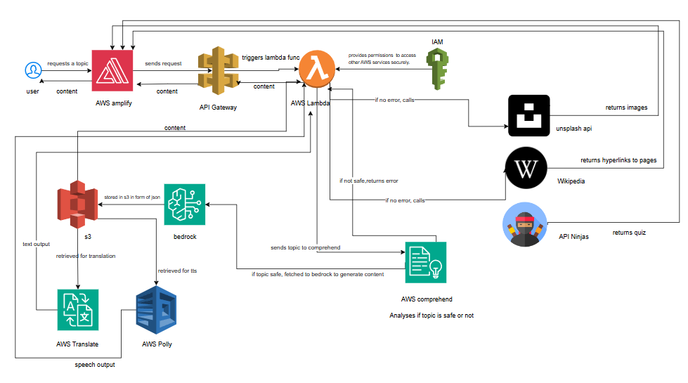
APP Architecture

Slide 6
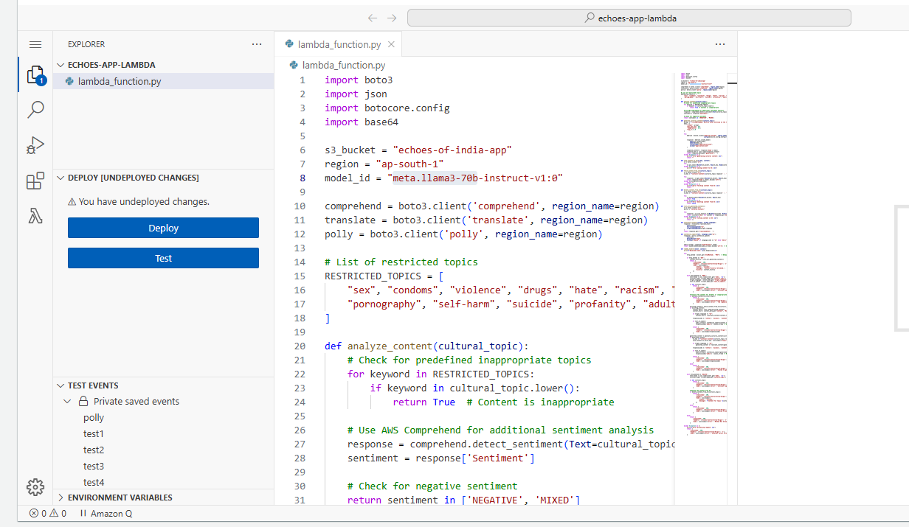
Lambda function and IAM role config

Slide 7
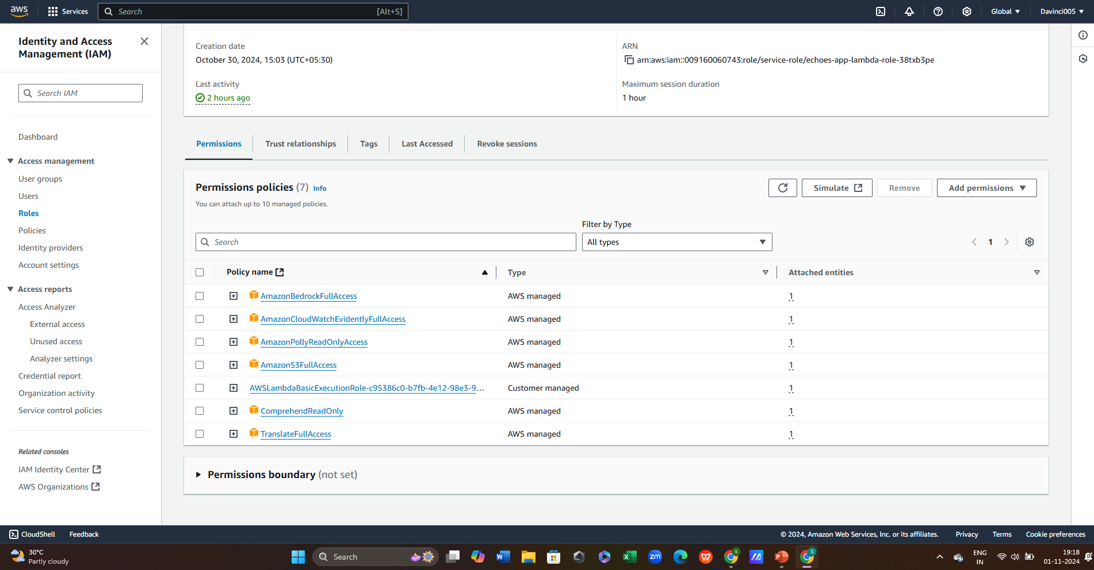
Lambda function and IAM role config

Slide 8
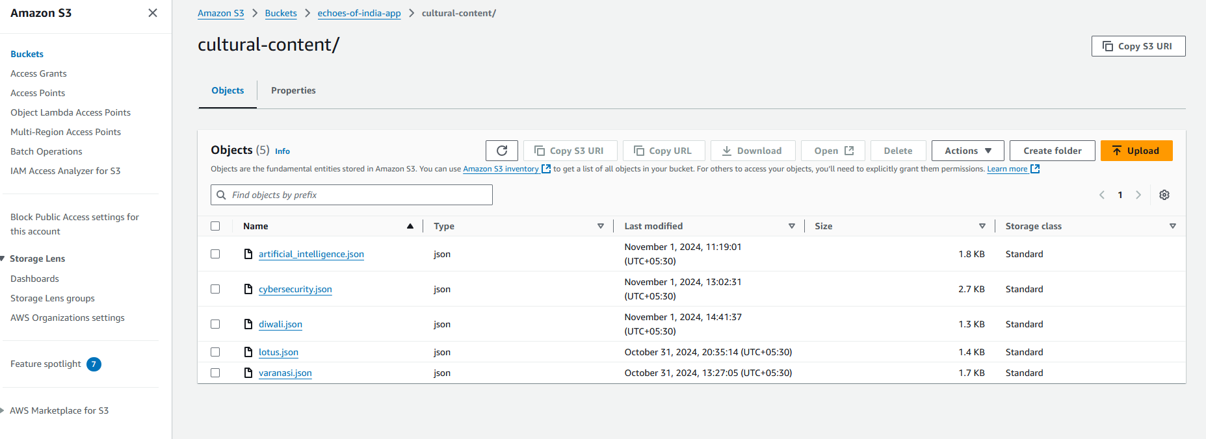
S3 bucket

Slide 9
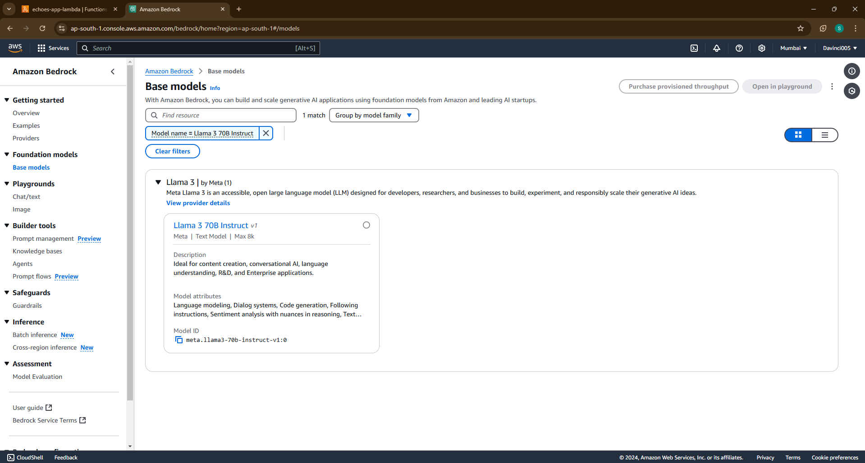
Amazon bedrock model

Slide 10
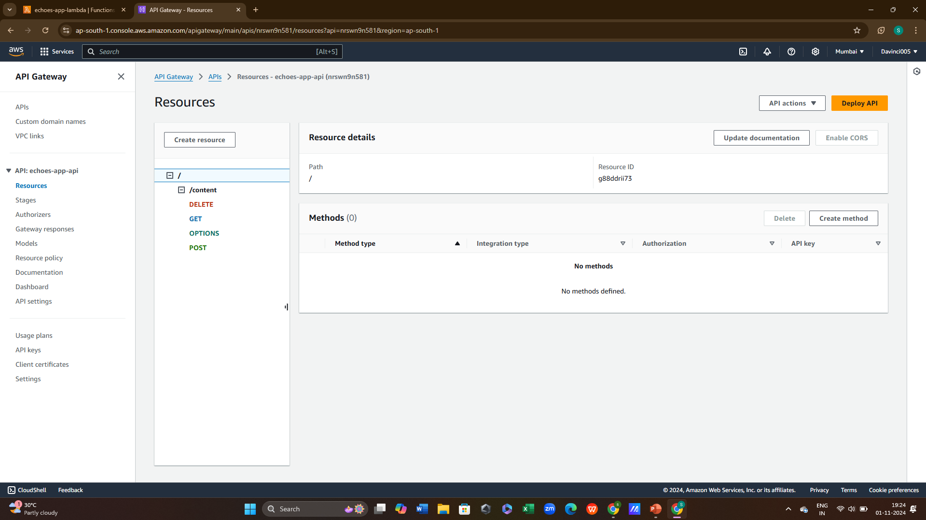
API Gateway

Slide 11
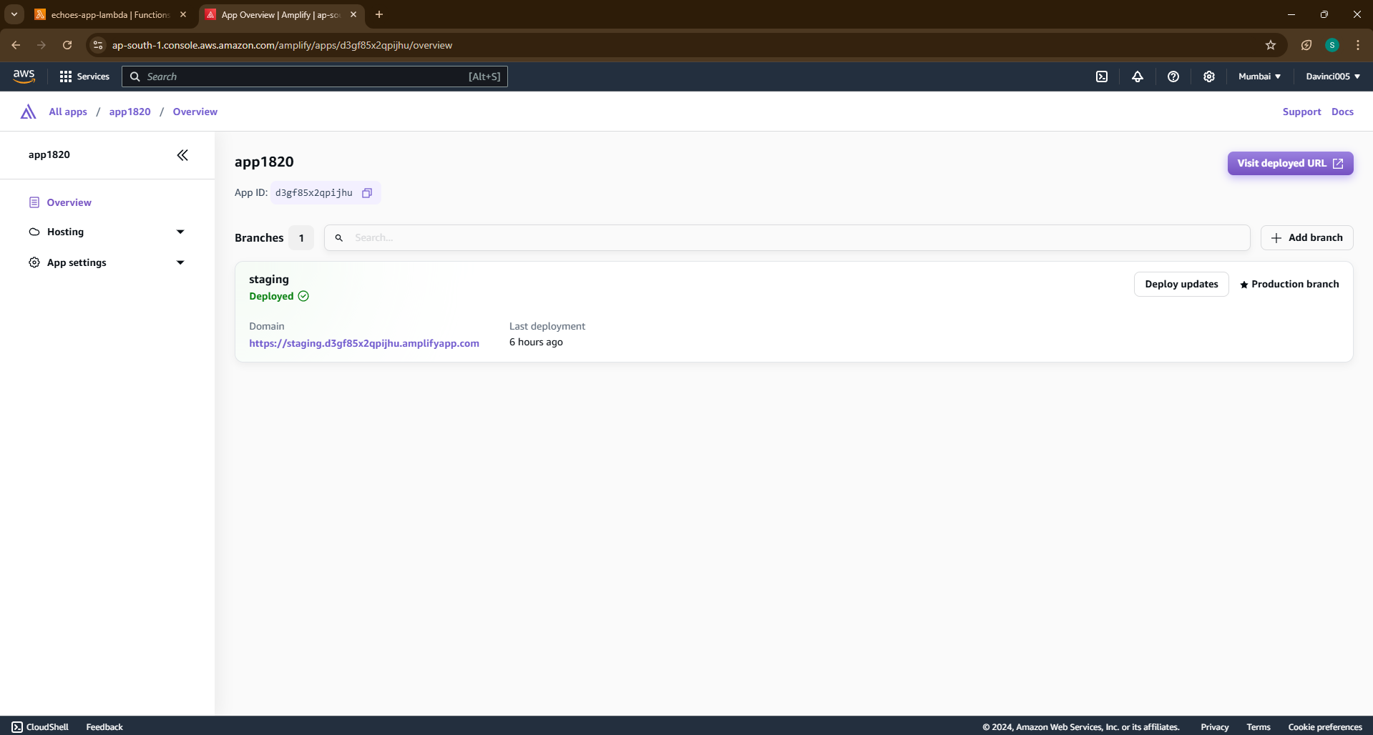
Amplify

Slide 12
Overall features of InfoSphere
Content Generation: Utilizes AI models on AWS Bedrock to create comprehensive overviews of specified cultural topics.
Content Moderation: Implements AWS Comprehend for sentiment analysis and keyword detection to filter out inappropriate topics.
Multilingual Support: Leverages AWS Translate to provide translations of the generated content in multiple languages.
Text-to-Speech: Uses AWS Polly to convert text content into audio, offering an engaging user experience.
Data Storage: Stores generated content in Amazon S3 for easy retrieval and management.

Slide 13
Advantages
Modularity: Each function is well-defined and modular, making it easy to maintain and test.
Scalability: Utilizing AWS Lambda allows the application to scale effortlessly based on demand.
Language Support: The integration of translation and speech synthesis makes the application accessible to a wider audience, accommodating users who speak different languages.
Content Moderation: The use of sentiment analysis ensures that the content generated adheres to community guidelines, improving safety and user experience.

Slide 14

Scope for improvements
Enhanced Content Moderation: The application can be improved by integrating more sophisticated content moderation techniques, such as machine learning models that can understand context better than simple keyword checks.
User Authentication: Implementing user authentication can help manage user data, preferences, and content more effectively, allowing for personalized experiences.
UI/UX Improvements: Depending on the previously provided UI code, there may be opportunities to enhance the user interface for a better user experience, such as implementing a more intuitive design, adding progress indicators, or providing feedback during long-running processes.
Error Logging and Monitoring: Integrating a logging solution (like AWS CloudWatch) could help in monitoring application performance and quickly diagnosing issues.
Content Curation Features: Implement features that allow users to curate or favorite content, providing a personalized experience and encouraging user engagement.
Performance Optimization: Review the performance of external API calls (like Comprehend and Translate) and optimize where possible, perhaps by batching requests or caching results.
Multi-Model Support: If Bedrock can support multiple models, allowing users to choose from different generation models can improve content variety and quality.

Slide 15
Thank you
Sai Saranya Mulukutla
saisaranyamulukutla@gmail.com

